Slide 1
Experiment 7 Supervised Machine Learning Algorithms using Knime Analytics Platform
Dr. Anisha Natarajan
Assistant Professor
School of Electronics Engineering
anisha.natarajan@vit.ac.in

Slide 2
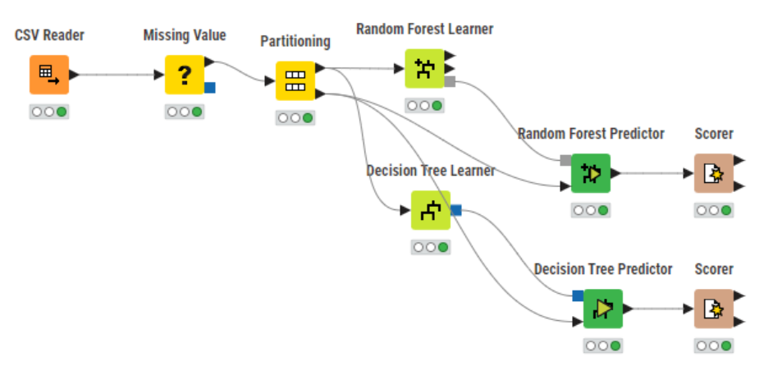
Work flow

Slide 3
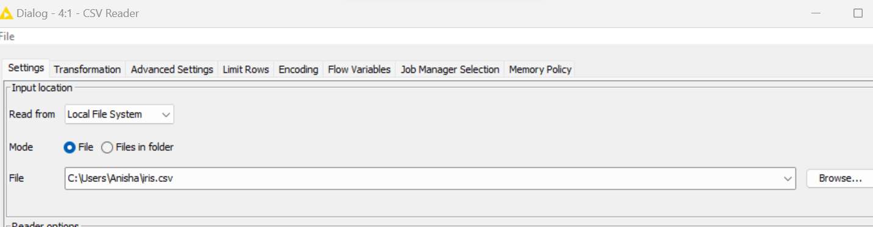
Load iris.csv dataset

Slide 4
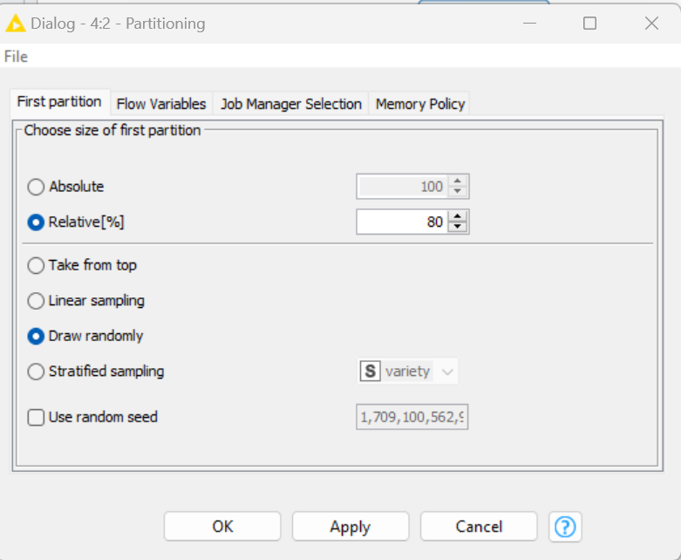
Partitioning node settings

Slide 5
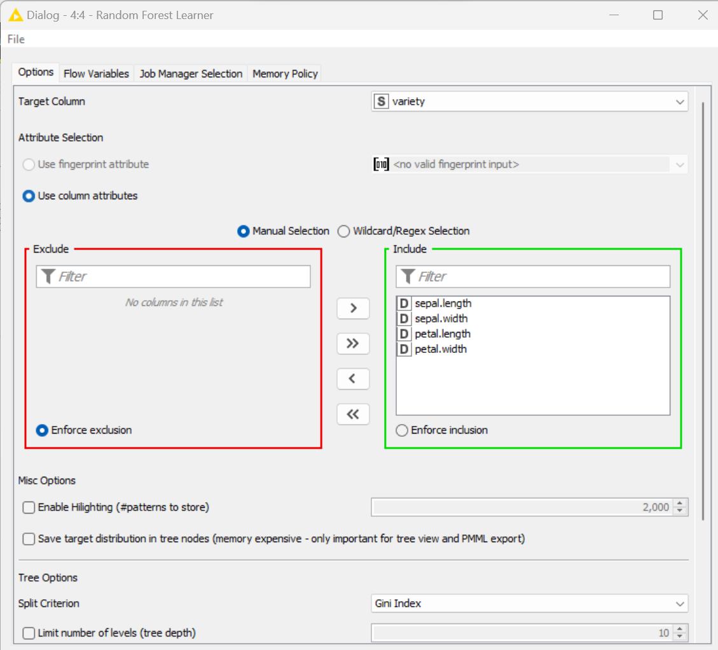
Random Forest Learner settings- split Criterion –Gini Index

Slide 6
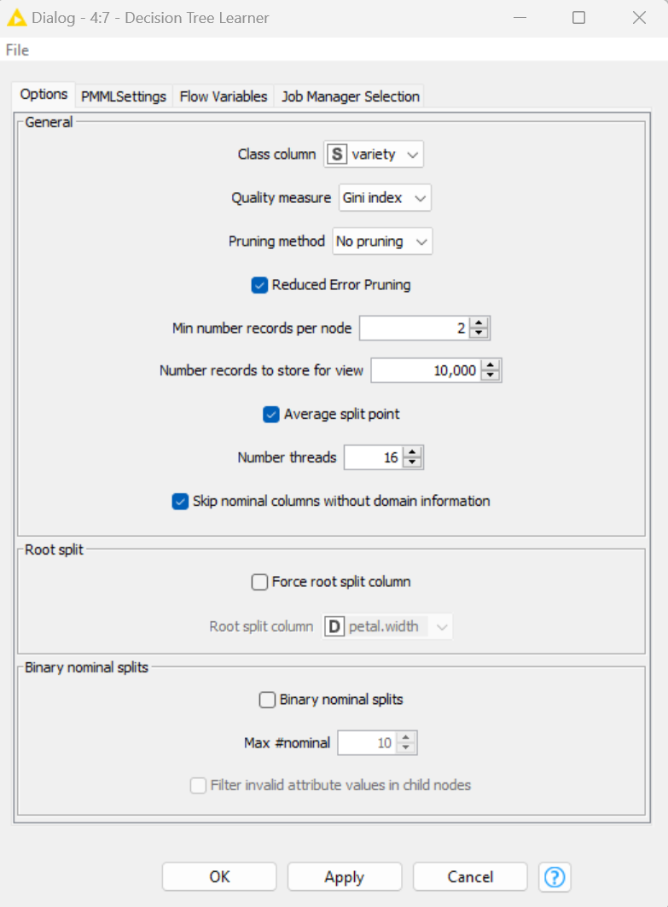
Decision Tree learner settings

Slide 7
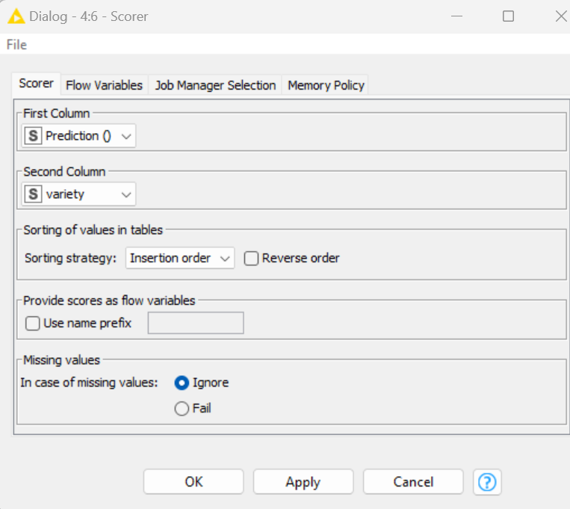
Scorer settings

Slide 8
Execute all the nodes
Double click on the scorer node for both the classifiers
Compare the confusion matrix and accuracy statistics of both Random forest model and decision tree model. Which one offers better results?
TASK: Implement the following classifiers using Knime and compare the scores for the iris dataset and diabetes dataset:
Naïve Bayes
SVM
Gradient Boosting
Multi layer perceptron

